Slide 1
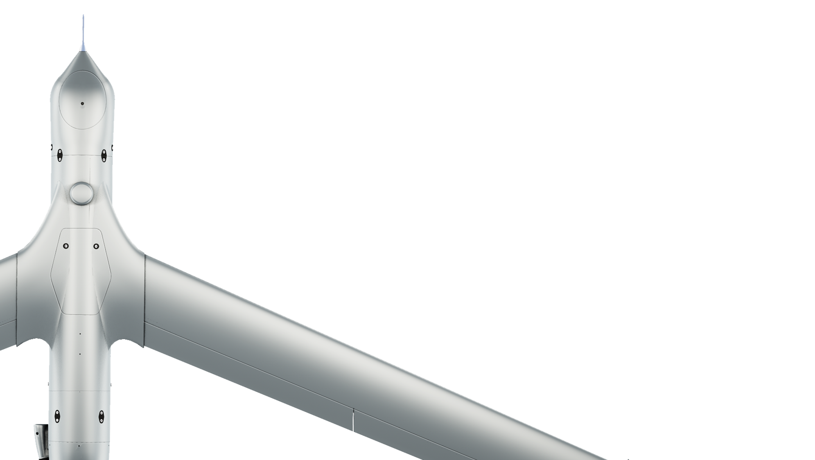
AS9102 FAIR Training
(First Article Inspection Report)
For Insitu Suppliers

Slide 2
Outline
Slide Title | Slide #
Purpose of this Training | 3
Purpose of a First Article | 4
Definitions | 5
When is a First Article Required | 6
Supplier Responsibilities | 7
What to include in the FAIR package | 8
Bubbled (Ballooned) Drawing/Specification | 9
Nonconforming Material | 10
Form 1 Part Number Accountability | 11
Form 2 Product Accountability | 13
Form 3 Characteristic Accountability, Verification, and Compatibility Evaluation | 15
Questions and Contact | 21

Slide 3
Purpose of this Training
The purpose of this presentation is to help Insitu suppliers understand how to deliver First Article Inspection Reports that meet Insitu’s requirements.
The purpose of an AS9102 First Article and its associated inspections (FAI) and report (FAIR) is to both protect the supplier and provide assurance to the customer that the supplier is capable of making the contracted product.
At the end of this presentation, Insitu suppliers will be able to successfully submit a production First Article with its associated First Article Inspection Report, including all required documentation.

Slide 4
Purpose of a First Article
A First Article Report provides objective evidence that all engineering, design and specification requirements are correctly understood, accounted for, verified, and recorded.
Note: See AS9102 Section 1.2 for full description of the purpose of FAI

Slide 5
Definitions
First Article:
A part or assembly that is produced using the prescribed production manufacturing process for the purpose of ensuring that the manufacturer is capable of producing a product that will meet specified requirements.
First Article Inspection (FAI):
A complete and documented physical and functional inspection process to verify that prescribed production methods have produced an acceptable item as specified by engineering drawings, planning, purchase order, engineering specifications, and/or other applicable design documents.
First Article Inspection Report (FAIR):
A package of documents for a part or assembly, including FAI inspection results, that demonstrates the part or assembly meets the specified requirements.

Slide 6
When is a First Article Required
The part is being introduced into production for the first time as a result of a new product development.
The part is being sourced from a new supplier (or new sub tier supplier).
The part manufacturing location has changed.
In the judgment of Insitu Engineering or Quality, changes have been made to the manufacturing process/work instructions that could affect product conformance.
The part has been released at a new revision level.
As requested at the discretion of the Insitu SQE.
Whenever there has been a gap in production of 2 or more years.
Note: See AS9102B Section 4.1 and Insitu PROC-00900 for full requirements

Slide 7
Supplier Responsibilities
Notify Insitu Quality prior to any change being implemented which would require a new First Article
Provide a FAI/FAIR when requested by PO or when supplier change meets criteria of slide 6
Implement FAI with sub-tier suppliers
Retain FAIR records in accordance with PROC-00900
Provide documented control plan(s) for Insitu specified Key, Critical or Significant to Quality characteristics.
Provide feedback for issues with drawings, material, and processes through the SREA process (Supplier Request for Engineering Approval).
The FAIR and PFAIR is to be done by the Manufacture (AS9102 Section 1.2)
Supplier to Reach out to Insitu SQE to determine whether a Full or a Partial is required when the full FAIR is invalidated prior to completing a new FAIR activity

Slide 8
What to include in the FAIR package(objective Evidence)
AS9102 forms 1-3 (always include)
Ballooned Drawing (always include)
CoC of finished product (always include)
Subassembly FAIRs (when requested by Insitu Quality)
Material Certs (when applicable)
Special process Certs (when applicable; refer to PROC-00900)
CoC of sub-components (when applicable)
PCB test coupon report (when requested by Insitu Quality)
IUID Grade Report (when IUID is required by the drawing)
Test documentation (when applicable)
Control Plan (when applicable)
Insitu Approved NCMR (when applicable)
Notes:
When creating FAIR packages, it is recommended to use a software solution such as DISCUS, Visual FAIR etc.
Verify drawing notes to make sure processes are followed and documented for ESD and IPC standards, etc.
All documents submitted as a single Adobe type PDF to FAIR@insitu.com
FAI part tagged so it can be identified on receipt at Insitu. You can also indicate FAI on the packing slip (not in fine print) and on the package.
Part Marking Verification required for all levels of an assembly
Proprietary information may be redacted
For additional details on special process please contact your Insitu SQE

Slide 9
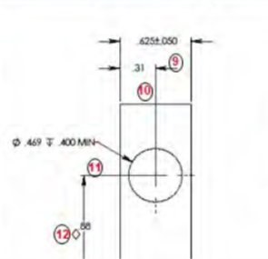
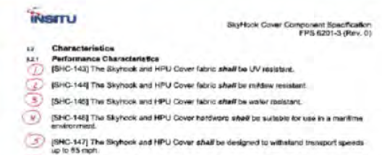
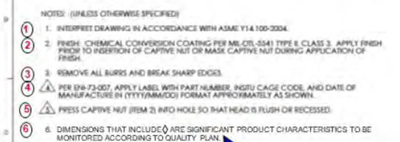
Bubbled (Ballooned) Drawing/Specification
A bubble is a circled or boxed character that is used to identify the location of a requirement definition and is used to identify the inspection or measurement of the definition on the Characteristic Results Form.
Print Example 1
Print Example 2
Specification example
Notes:
It is not a requirement to start with the notes, but is a best practice
All notes and instructions should to be bubbled
Reference and basic dimensions do not need to be bubbled
All specification definition is to be bubbled
Specification example
Notes:
Basic or Reference Dimensions do not need to be bubbled.
When a Characteristic has multiple spots where the dimension applies either all results need to be provided or the range(low-high). Multiple results should be ballooned i.e. a 3X dimension should use the numbering 3, 3.1 3.2.
Ballooning a Specification will be clarified by the Insitu SQE. A compliance matrix may be accepted as an alternative to ballooning the specification.

Slide 10
Nonconforming Material
A nonconformance is any requirement that is not met. A nonconformance number allows for traceability to the rejection and disposition of the nonconformance. Nonconformance numbers are issued by Insitu and will look like SU followed by 8 digits e.g. SU00012345.
Supplier will be issued a SU number after submitting FORM-01537.
Nonconforming deliverables shall not be shipped until Supplier has received approval from Insitu Quality.
The SU number is listed on AS9102 Form 1 block 8
Form block 19 is checked “Yes.”
Form 3 block 11 should list the SU number next to the out of tolerance character.
https://iaqg.org/standard/9102-first-article-inspection-requirement/

Slide 11
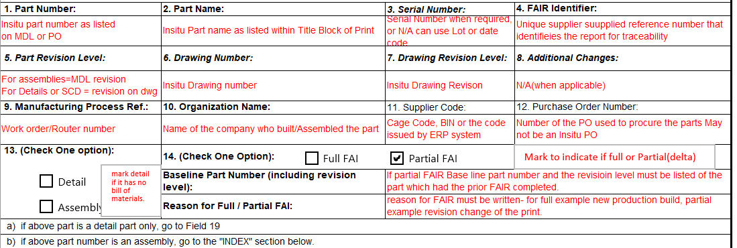
Form 1 Part Number Accountability
Slide 1 of 2
Insitu Part Number as listed on PO
Insitu Part revision as listed on PO
NCMR listed here when applicable e.g. SU00012345
Page break
Page break

Slide 12
Form 1 Part Number Accountability (continued)
Slide 2 of 2
Page break
Page break
Page break
Page break
MDL and MDL Revision if applicable

Slide 13
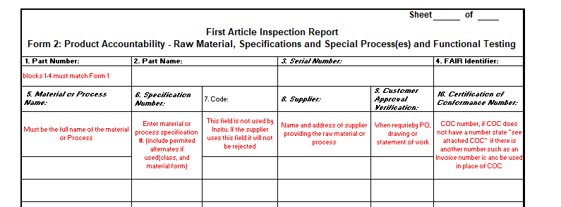
Form 2 Product Accountability
Slide 1 of 2
Page break
Page break
Notes:
All Raw materials are to be listed on the form.
Special processes as defined by PROC-00900 should be listed here.

Slide 14
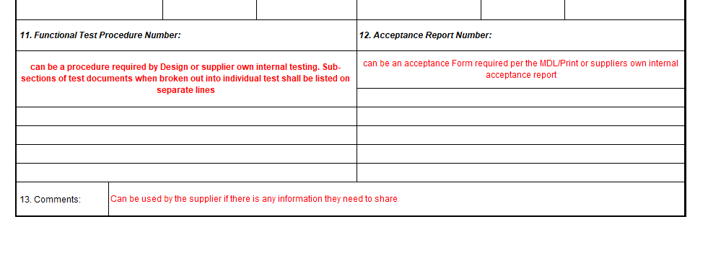
Form 2 Product Accountability (continued)
Slide 2 of 2
Notes:
Functional Tests listed on the drawing should be listed here and included in the FAIR package. E.g. IPC testing requirements for cables

Slide 15
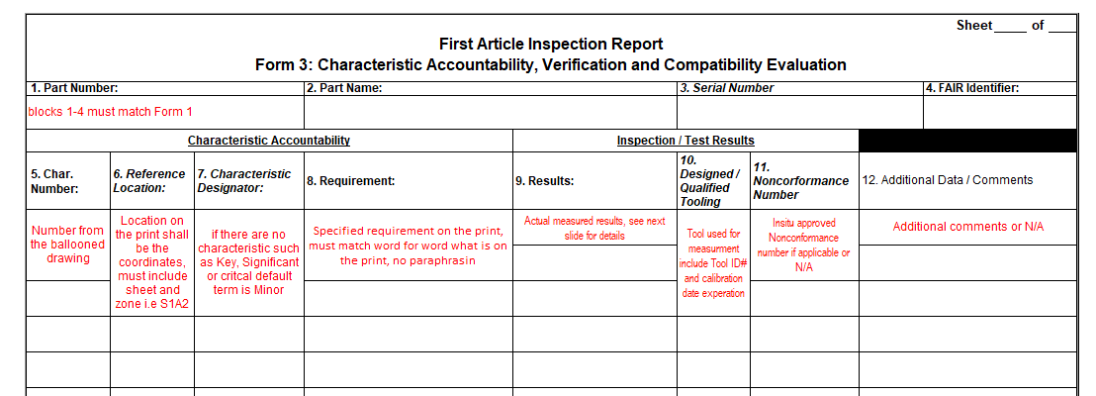
Form 3 Characteristic Accountability, Verification, and Compatibility Evaluation
Specified required on the print, must match word for word what is on the print. No paraphrasing
Notes:

Slide 16
Form 3 Characteristic Accountability, Verification, and Compatibility Evaluation (continued)
Field 9) Results
List measurement(s) obtained for the Design Characteristics.
For Multiple Characteristics list each characteristic as individual values measured i.e., 2x or 3x. If a characteristic is found to be nonconforming then that characteristic must be clearly identified with the measured value noted.
If a Design Requirement requires verification testing, then the actual results will be recorded on the form. If a laboratory report or certificate of test is included in the FAIR, then these results need not be written on the form. However, record the report reference number in block 14. The laboratory report or certificate of test must show specific values for requirements and actual results.
For metallurgical characteristics with visual verification requirements, that are rated against standard photographs, list the photo number of the closest comparison. A statement of conformance is acceptable (record the reference number in block 14).
For other processes that require verification per Design Characteristic, include statement of conformity
(i.e., certification of conformity, verification indicator such as .accept., etc.)
For part marking, ensure that marking is human readable, correct in content and size and properly located, per applicable specification.
(i.e., IUID information, Insitu Serialization requirements, etc.)
For notes which provide information such as “item not shown on Print” use of the following is acceptable:
Noted
Information
Acknowledged

Slide 17
Partial FAIR AKA Delta FAIR
Only include what information has changed since the last time a FAIR has been completed
e.g. nonconformance measurements have been resolved and part is conforming
All Forms need to be submitted- N/A the fields which do not apply i.e., for an assembly if no change was to the Bom the Bom fields on form 1 will be N/A you will only need to fill out the header and sign the form.
If no change to supporting documentation it does not need to be resubmitted
Coordinate with your SQE and Procurement agent on cut in if there are existing PO’s that are impacted
PROPRIETARY AND COMPETITION SENSITIVE SUPP-01989 Insitu Supplier FAIR Training (Rev 2)

Slide 18
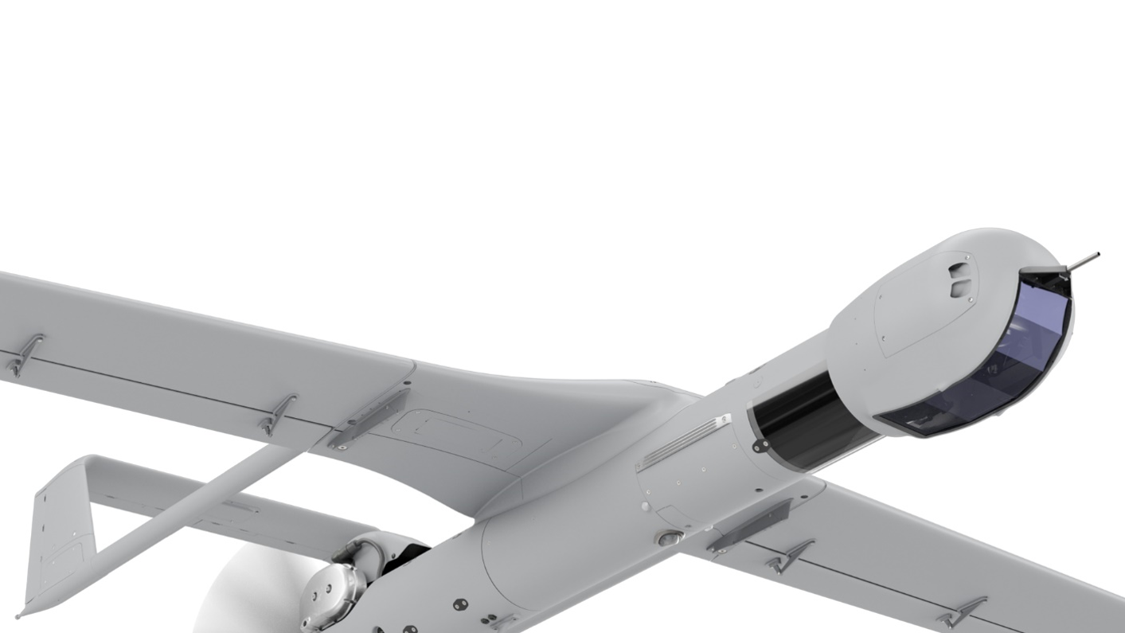
Thank You!
Have questions, feedback, or need assistance?
Please email FAIR@insitu.com and your Insitu Supplier Quality Engineer for support.

